Slide 1
DS203
Programming for Data Science
Exercise 7
Project
GROUP 9
21D170016: Garv Gupta
21D170046: Vishesh Kamani
21D171001: Akash Sansagu Palaniswami
21D180011: Faiz Nawaz

Slide 2
Problem Statement
An architecture firm has digitized its building layouts into 640x480 bitmap images to enhance productivity and adapt to customer needs. They aim to use data science and machine learning to categorize designs into families based on structural shapes, deepening design insights and standardizing processes through templates.

Slide 3
Problem Statement
Classify the complexity of their building layouts. Perform an analysis to develop criteria for categorizing layouts into Low, Medium, and High Complexity. Utilize analytical techniques to establish these criteria and classify the layouts, enhancing design precision and efficiency.

Slide 4
Problem Statement
Accelerate the design process by retrieving relevant prior layouts based on parameters such as the dimensions of the tight-fitting box, layout area, and permissible complexity. By specifying these parameters, we should predict and retrieve designs from the most relevant families.

Slide 5
Our Approach
Use OpenCV to extract key features from layout images. Apply clustering algorithms to classify images into families.
Weights to features and calculate complexity scores using these weights. Define thresholds for low, medium, and high complexity to categorize designs effectively.
Train a machine learning model using tight-fitting box, layout area, and complexity for classification and use the model to predict relevant design families

Slide 6
Features
Deployed
For Clustering
Variance of Internal Angles
Variance of Side Length
Number of Corners
Number of Concave Corners
Average Distance from Centroid
Variance of Distance from Centroid

Slide 7
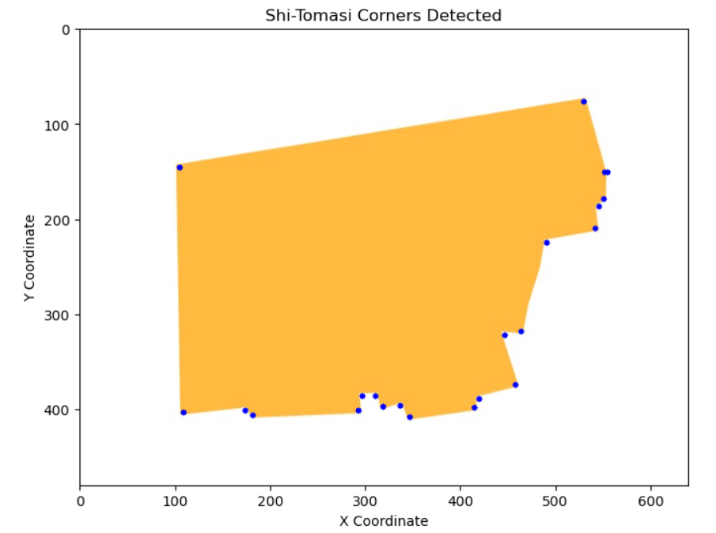
Counting Number of Corners
We are using the Shi-Tomasi Corner Detector to get the corners. It has been implemented using goodFeaturesToTrack by OpenCV
Example: image 0783 gives us 22 corners

Slide 8
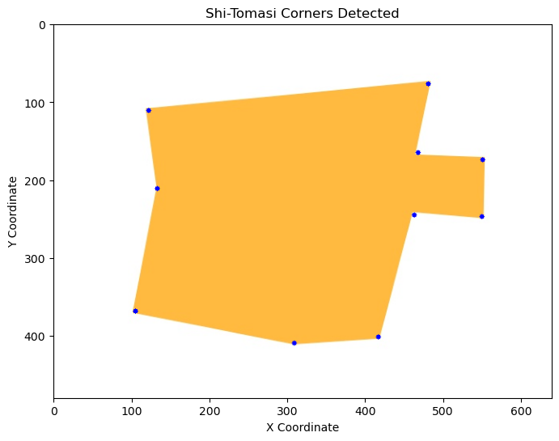
Other Features
The corners are detected using Shi-Tomasi
The interior angle and side length information is extracted using OpenCV to make a contour
Canny edge detection is used to get the centroid data
Features for Image 0284 | Value
Std of Angles | 71.79
Std of Sides | 83.13
No. of Corners | 10
No. of Concave Corners | 3
Avg Distance from Centroid | 203.58
Std Distance from Centroid | 35.68

Slide 9
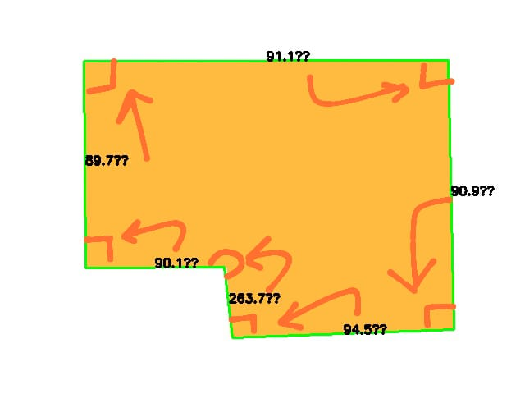
How are all the features extracted?
Number of corners in image are ascertained by approximating the contour using approxPolyDP and finding its length
For the standard deviation of angle we take the coordinates of 3 points and find the angle using the cross product of the vectors while also adjusting in case of concave angles.

Slide 10
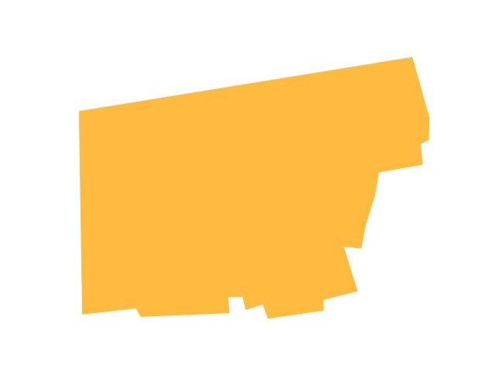
Distance of each vertices is calculated from the centroid and its mean and standard deviation is taken for comparison
Using epsilon value approximation for arc length to figure out the standard deviation in angles and number of concave corners(when angle is greater than 180°)
Contour area is calculated directly using in-built function contourArea()
Contour Area comes out to be: 115353.5

Slide 11
Classification into Families
t-SNE Dimensionality Reduction
K-Means Clustering
Hierarchical Clustering

Slide 12
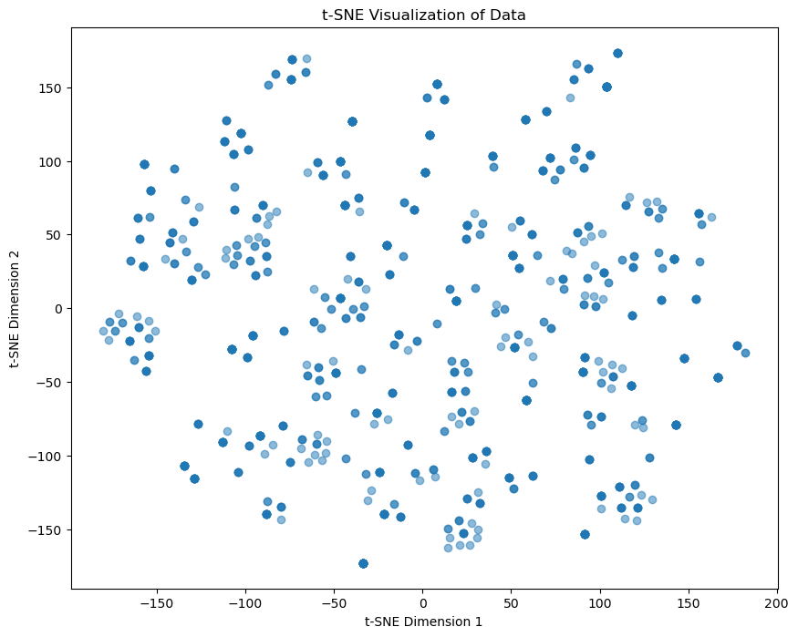
t-SNE Dimensionality Reduction
We used t-SNE to reduce dimensions and produce a 2D visualization. We see that there are indeed small clusters which could represent a family of designs with similar features.

Slide 13
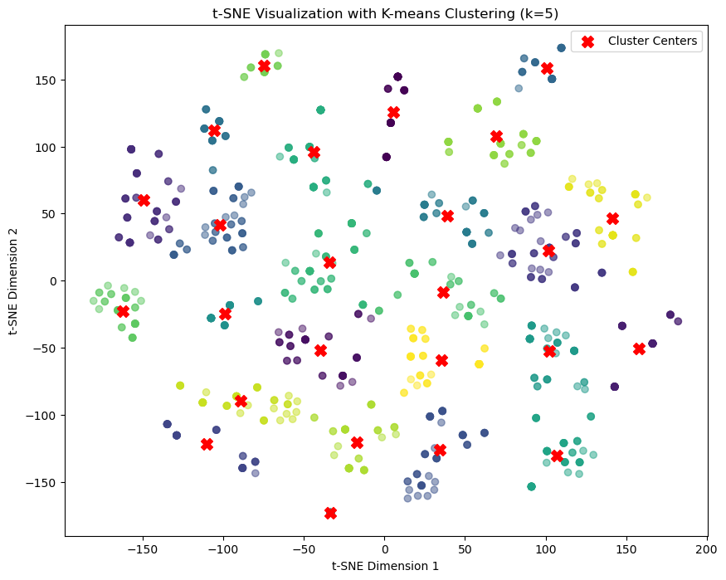
Using K-means
We then applied K-means clustering to segment the data into 25 distinct clusters . This categorizes designs into families, revealing patterns and similarities within the dataset. The features for clustering are the t-SNE dimensions

Slide 14
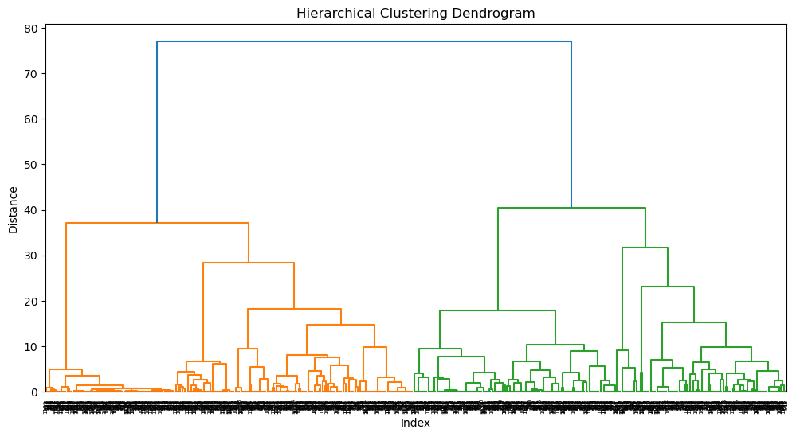
Using Hierarchical Clustering
For our second approach, we employed hierarchical clustering using all the original features. This method organized the data into a tree-like structure, allowing us to see a detailed breakdown of the dataset into progressively smaller groups based on similarity.

Slide 15
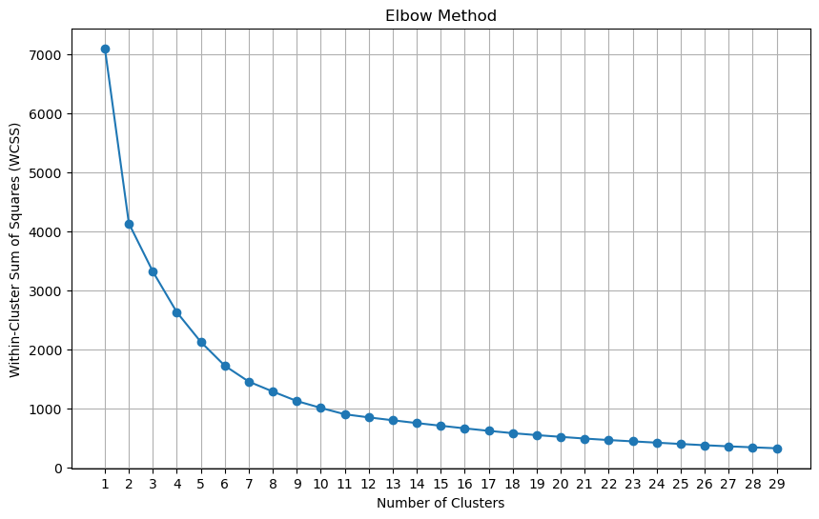
Finalising the number of clusters
Using Elbow Method with an assumption of 30 maximum clusters, calculating the within-cluster sum of squares for different number of clusters.
After value of n=26 there is no change so we assume that 26 can be taken as an approximate number of clusters for our designs

Slide 16
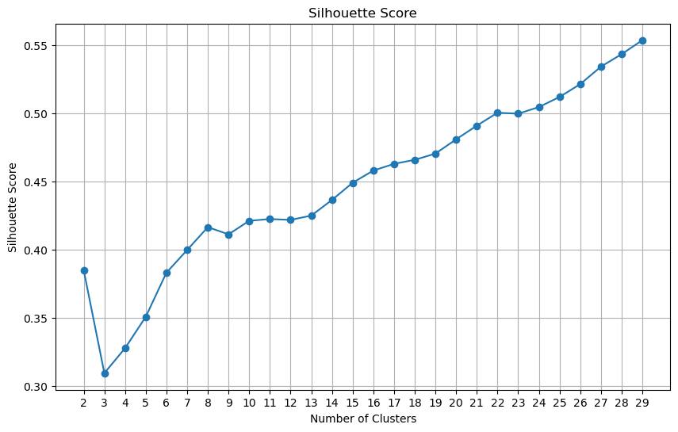
Finalising the number of clusters
Similarly using another metric Silhouette Score, we get an appropriate number of clusters.
In both the above methods we have scaled data and ‘maxclust’ criteria

Slide 17
Finalising the number of clusters
Using a higher number of clusters ensures high intra-cluster similarity, which facilitates the use of these clusters as cohesive families in subsequent analyses. This approach allows us to address broader problems by leveraging these well-defined families rather than individual images.

Slide 18
Complexity Classification
We decided to group the 25 clusters into, different complexities assuming design families have similar complexity
Features used for classifying the 25 clusters:
Number of corners
Number of concave corners
Standard deviation of the distance of vertices form centroid

Slide 19
Complexity Classification
We calculated the complexity score for each design family by taking a weighted sum of the average features. Based on our analysis, we then set appropriate thresholds to categorize the families into different levels of complexity keeping roughly equal number of images in each complexity.
No. of images with:
Low complexity: 348
Medium Complexity: 496
High Complexity: 339

Slide 20



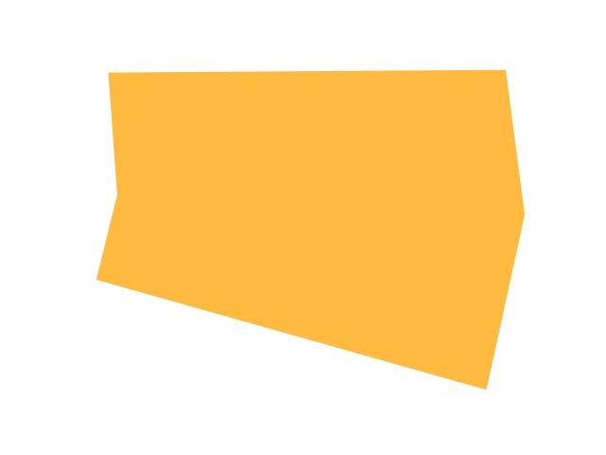



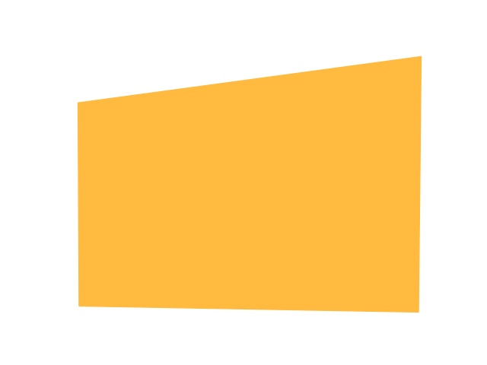
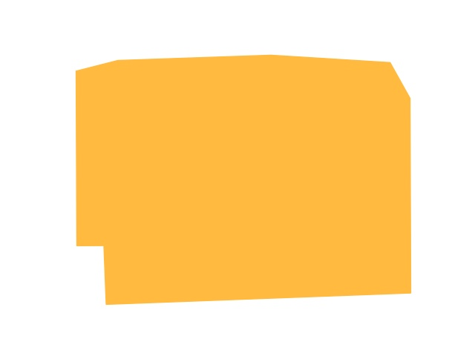


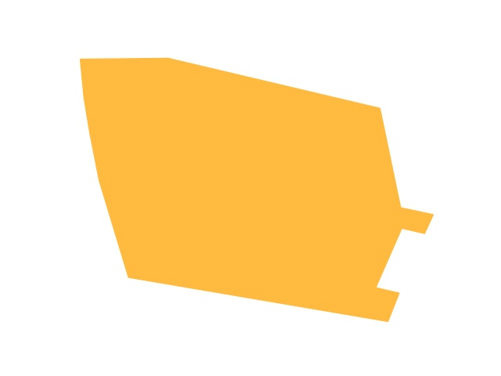
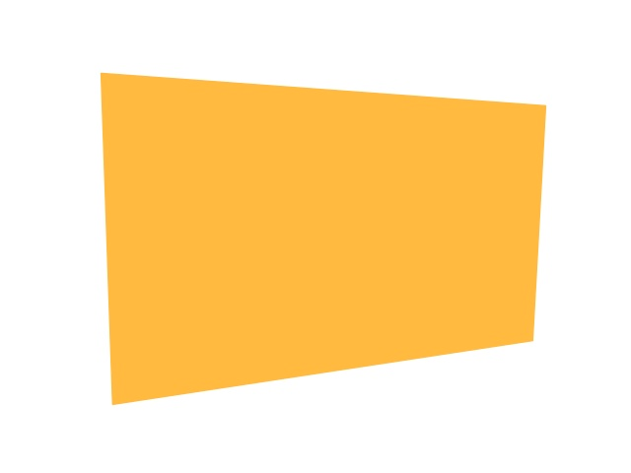
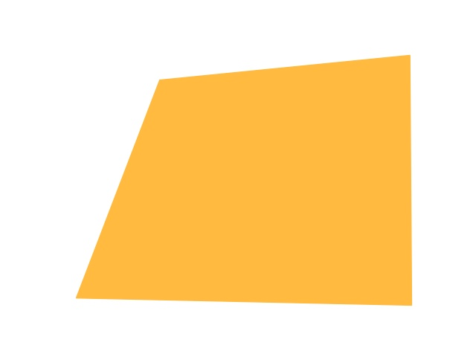


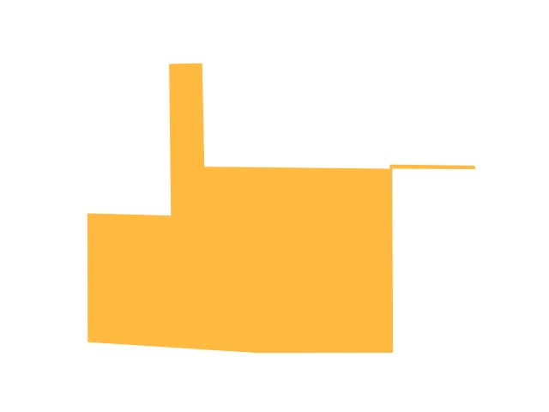
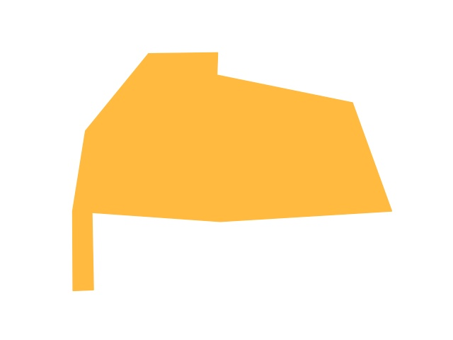
Low Complexity
Medium Complexity
High Complexity

Slide 21
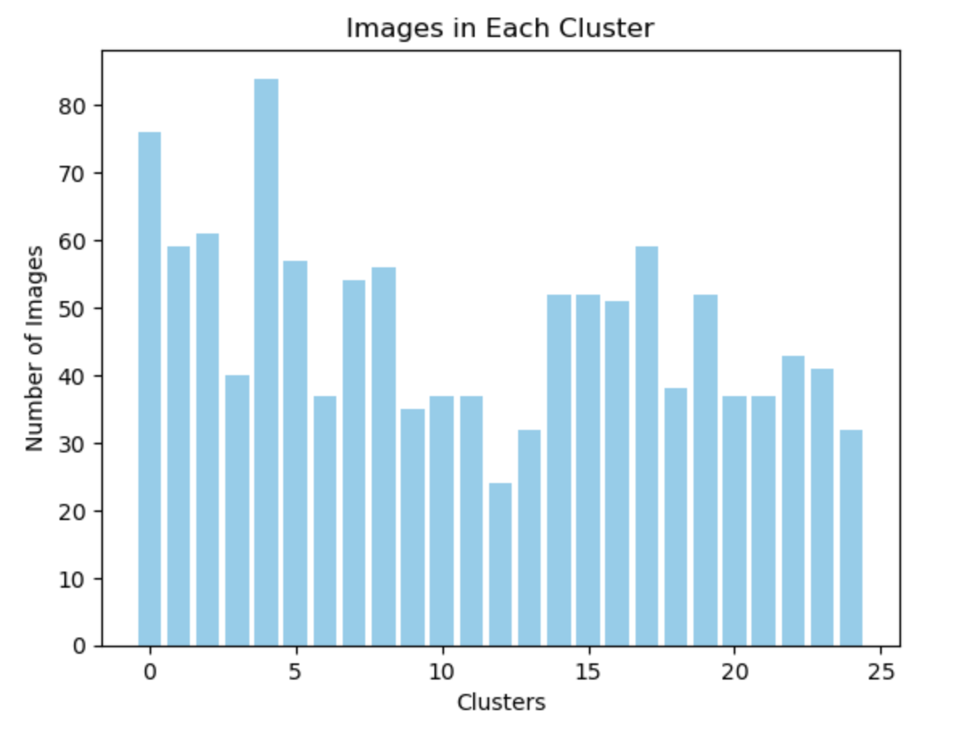
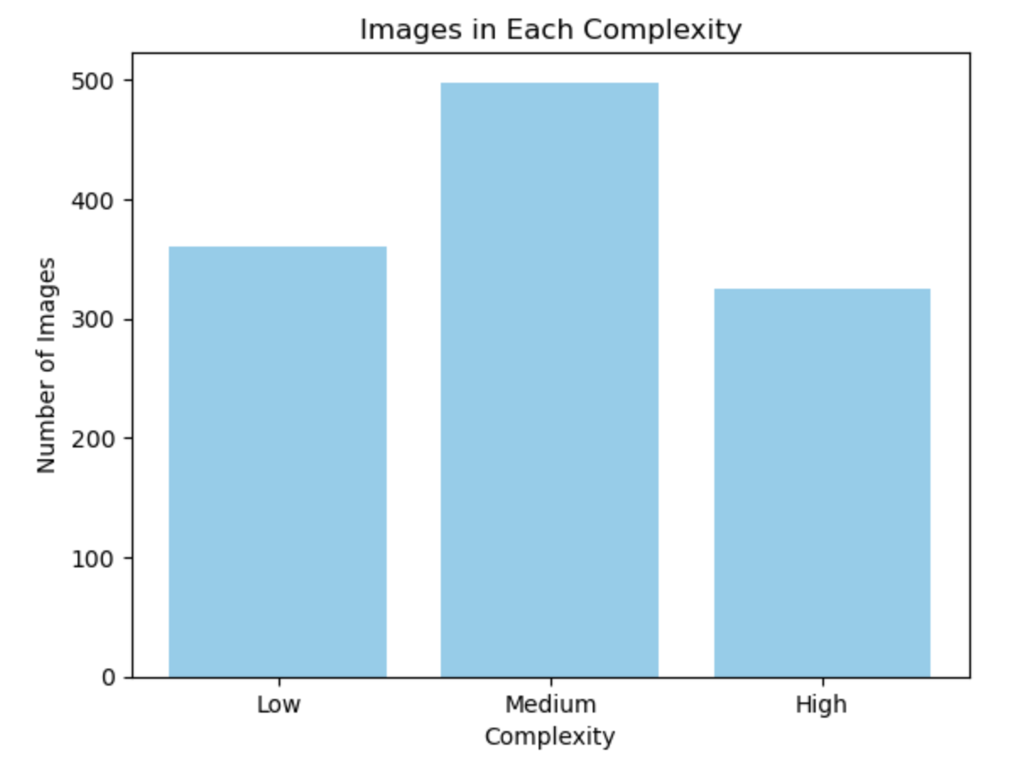
Some Results from the Analysis

Slide 22
Metric Values for each complexity
Metrics | Low Complexity(0) | Medium Complexity(1) | High Complexity(2)
Average Number of corners | 4.353 | 6.828 | 11.41
Average number of concave corners | 0.046 | 0.8387 | 3.539
Average Standard Deviation of angles | 10.026 | 42.177 | 61.553
Average Standard Deviation of side length | 88.683 | 111.08 | 91.09
Average Standard Deviation of distance from centroid | 7.906 | 34.123 | 45.067

Slide 23
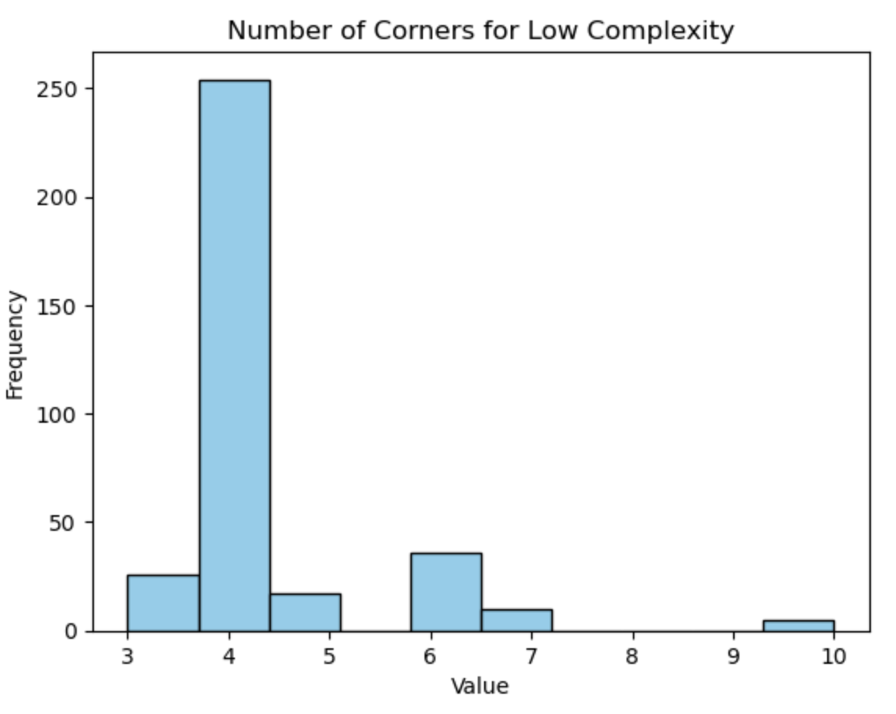
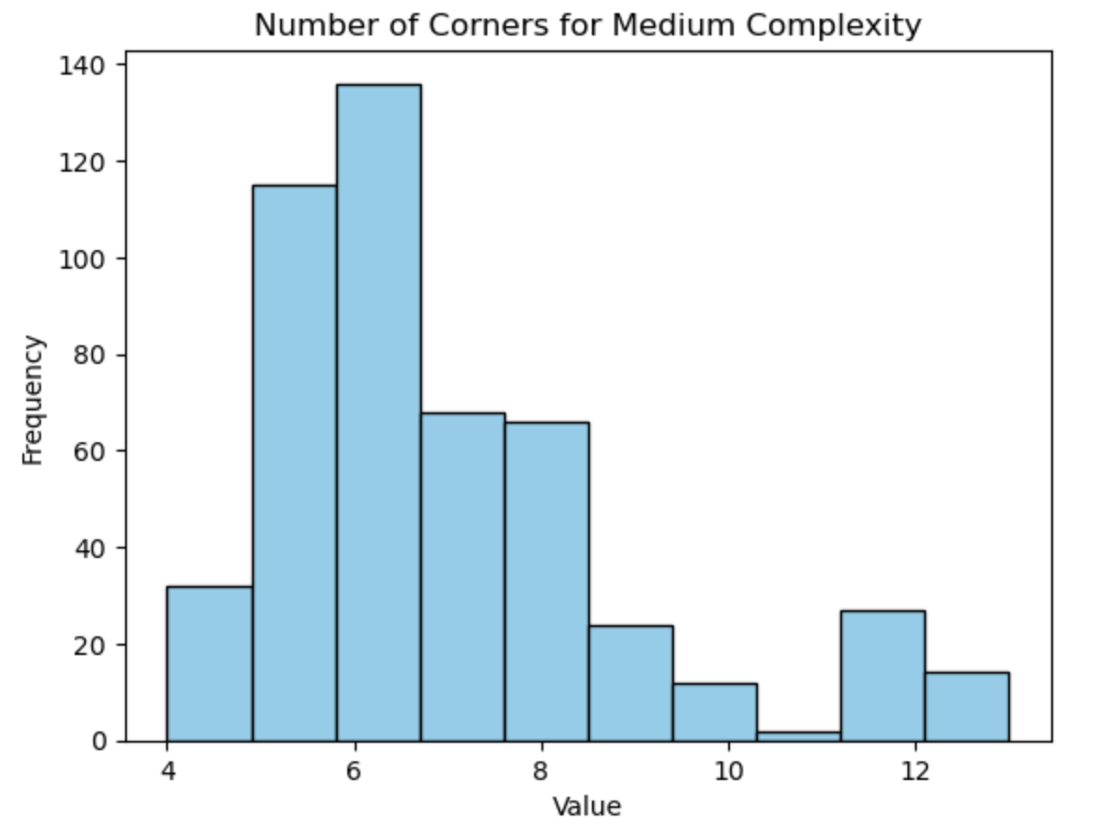
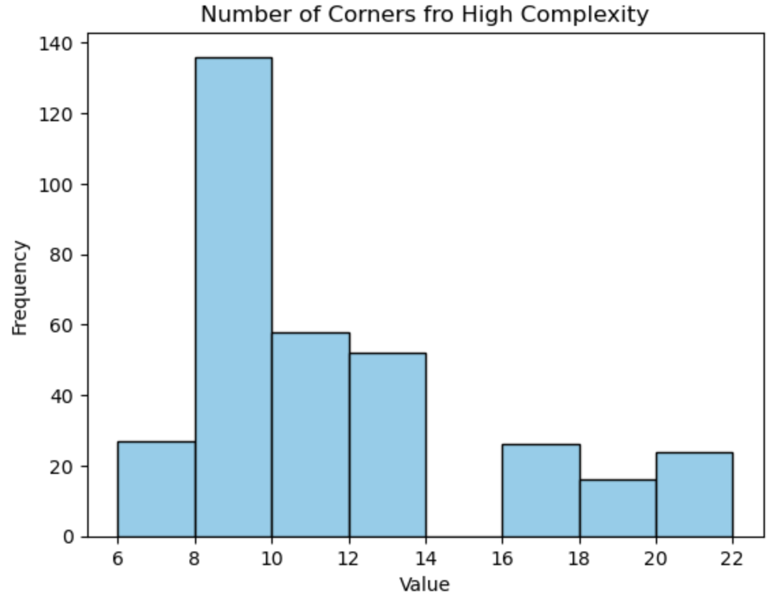
Number of corners distribution for each complexity

Slide 24
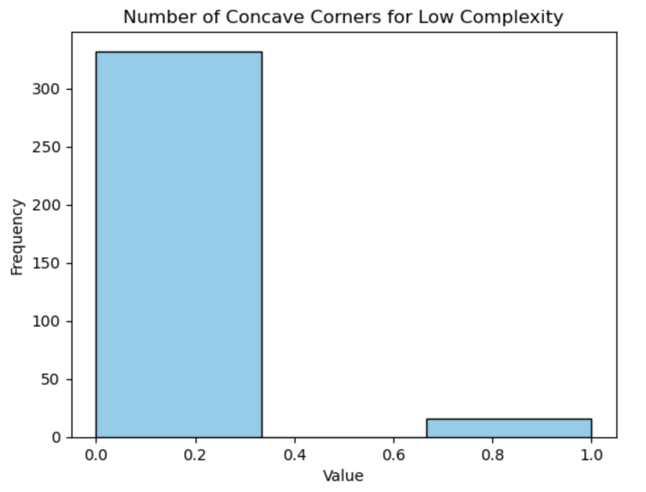
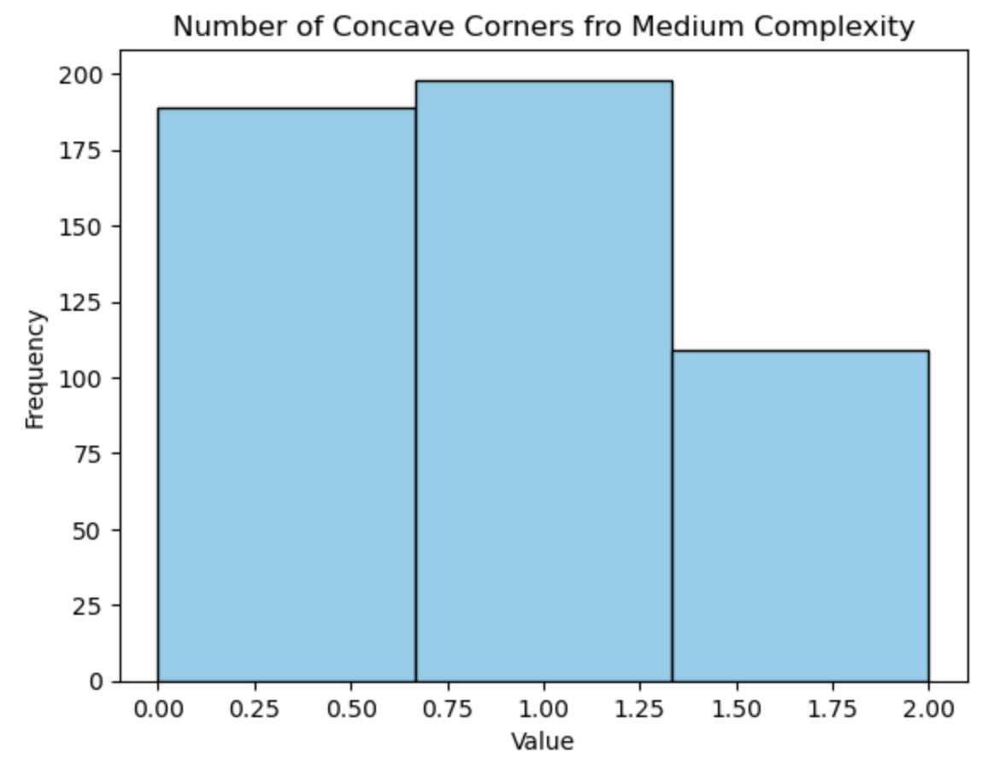
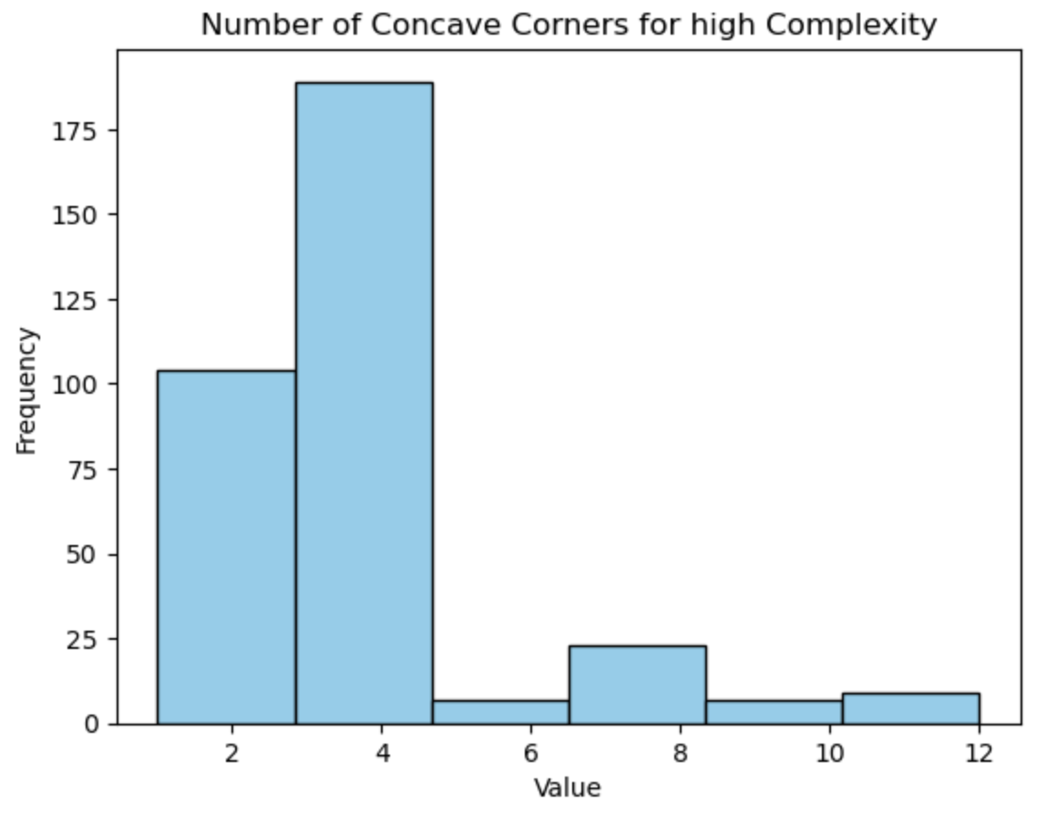
Number of Concave corners distribution for each complexity

Slide 25
Prediction and Retrieval of Relevant Prior Layouts
For this problem, we would want to predict the family which has the highest similarity to the parameters provided
We trained machine learning classifiers on parameters like dimensions of the tight-fitting box, layout area, and complexity with the target variable being the cluster label for the image
We then made a retrieval system which would display some of designs from the recommend family

Slide 26
Prediction and Retrieval of Relevant Prior Layouts
We have used OpenCV function minAreaRect to get the dimensions of the Tight-Fitting Box
We tested three classifiers: Random Forest, Support Vector Machine, and XGBoost, to evaluate their performance on our dataset

Slide 27
Classification report for each Classifier method
Random Forest Classifier
Support Vector Machine Classifier
Metric | precision | recall | f1-score | support
accuracy | - | - | 0.97 | 237
Macro average | 0.98 | 0.97 | 0.97 | 237
Weighted average | 0.98 | 0.97 | 0.97 | 237
Metric | precision | recall | f1-score | support
accuracy | - | - | 0.15 | 237
Macro average | 0.08 | 0.12 | 0.07 | 237
Weighted average | 0.08 | 0.15 | 0.08 | 237

Slide 28
Based on the final values of performance parameters, we can say that XGBoost and Random Forest classifiers give us the best results while support vector machine isn’t able to give good prediction.
XGBoost Classifier
Metric | precision | recall | f1-score | support
accuracy | - | - | 0.97 | 237
Macro average | 0.97 | 0.97 | 0.97 | 237
Weighted average | 0.98 | 0.97 | 0.97 | 237
Precision: Accuracy of positive predictions.
Recall: Coverage of actual positive cases.
F1-score: Harmonic mean of precision and recall.
Support: Number of true instances for each class.

Slide 29
Summary
Classification of Designs: We grouped designs into families based on key features, ensuring each family had similar designs.
Complexity Categorization: Assigned complexity levels to these families.
Recommendation System: Developed a machine learning-based system to match new designs with the best-fitting family templates.

Slide 30
THANK YOU!

